Slide 1
Biomass cookstove

Slide 2
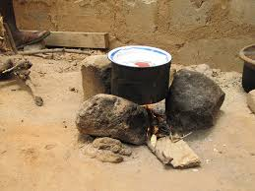
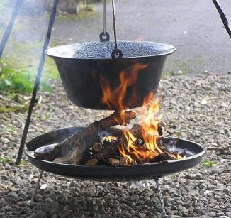
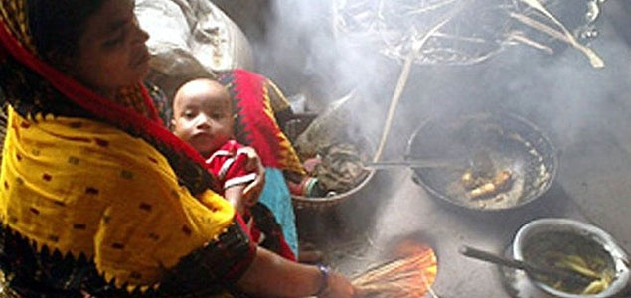
(1)
(2)
Traditional Cookstoves
&
Their Effect
(3)
Source: https://gocrowdera.com/SmokelessCookstoveRevolution/

Slide 3
Problems with Traditional Cookstove
Higher fuel consumption
Lower thermal efficiency
Higher harmful gaseous emissions such as CO, CO₂ etc.
Higher particulate matter emission

Slide 4
Introduction
67% of India’s population uses cook stove in their kitchen even today.
This comes to around 400 million people out of which 90% are women.
Worldwide, 2.6 billion people use cook stove with low efficiency, which use up more fuel and thus prove to be costly and polluting for its users.
Deaths due to HAP (Hazardous Air Pollutant) accounts to nearly 2% of total yearly deaths with a staggering number of 1.6 million people dying.
Improved cook stoves thus reduce these particulate emissions by almost 74% and CO emissions by 80%.
Improved cook stoves are mainly Natural and Forced Draft type.

Slide 5
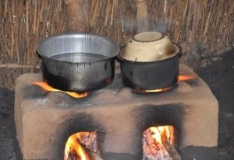
Background
Out of the 160 types of available ICS, very few have tried to focus on in-house pollution and emission control.
Some stoves, promising experimentally, failed in practice.
Chimneys transferred the gases out of the house, yet didn’t stop the pollution it caused.
Thus, it is very important to control the combustion of fuel in order to control the emissions cause.

Slide 6
History of ICS in India
The ‘Classic Phase’ of 1950’s saw Gandhian organizations focusing on Biomass cook stoves with the provision of chimneys.
No solid research done till 1980s.
The second phase began in India commercially since 1985, with the advent of Indian National Program On Improved Cook Stoves.
Today the main objective of stove programs is improvement of health and environment, over and above fuel efficiency.
Although, only 40% people in developing countries like India, have efficient cook stoves in their kitchens.

Slide 7
Concept behind gasification
What is Gasification?
Gasification is a partial oxidation process whereby a carbon source
such as coal, natural gas or biomass, is broken down into
carbon monoxide (CO) and hydrogen (H₂), plus carbon dioxide (CO₂)
and hydrocarbon molecules such as methane (CH₄).
This mixture of gases is known as producer gas & it is itself a fuel.
Partial
amount
of air
Biomass
Producer
gas

Slide 8
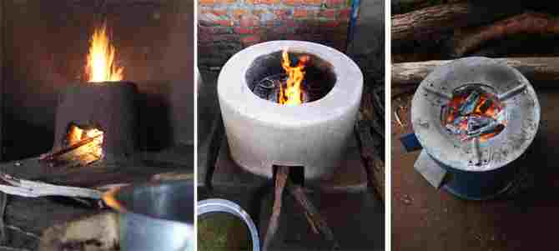
Types of Cookstove
Based on Purpose – Single Function and Multi-Function Cook stove.
Based on Portability – Fixed Stove and Portable Cook stove.
On the basis of Chimney used.
On the basis of Constructing Material – Mud, Metallic, Cement, Ceramic and Hybrid Cook stove.
On the basis of Fuel-type – Wood, Agricultural residue, Charcoal, Dung cake and Multi fuel cook stoves.
Mud Cookstove Cement Cookstove Improved Cookstove
Mud Cookstove Cement Cookstove Improved Cookstove

Slide 9
Advantages:
The main purpose - elimination of the harmful smoke released by burning solid fuels in the traditional cook stoves.
Improved cookstoves - practically completely smoke free and the minute particulate matter remaining can also be filtered.
Other main feature - the fuel flexibility.
Improved cookstoves - reduces deforestation and reduces the dependency on forests for fuel requirements.
Side advantage - create employment and jobs for the manufacture of this stove.

Slide 10
Comparison:
Sr.No | Improved cook stove | Traditional cook stove
1. | Complete combustion is possible. | Complete combustion is not possible.
2. | Use of improved cook stove helps to decrease premature deaths. | Use of traditional cook stove causes more premature deaths due to indoor pollution.
3. | Emission of unburnt gases is less. | Emission of unburnt gases is more.
4. | Reduces the effect of global warming. | Causes an increase in global warming.
5. | Efficiency is 35-40%. | Efficiency is around 10-15%.
6. | Can be easily moved from one place to other. | It is not portable.
7. | Cooking is more effective and consumes less time. | Cooking consumes more time.

Slide 11
Natural Draft Cookstove
No external device used
Force Draft Cookstove
Fan/blower is used

Slide 12
Government Initiative:
MNRE started - nationwide biomass awareness project (NBCI) - purpose of increasing the usage of cook stoves in India.
Also - laboratories and testing centers - maximize the efficiency of cook stoves, along with strength and ease in use.
Testing protocol for the biomass cookstoves - by BIS - four testing labs developed in India - supported by MNRE.
Approved chulha by MNRE – Unnat Chulha Abhiyan Programme

Slide 13
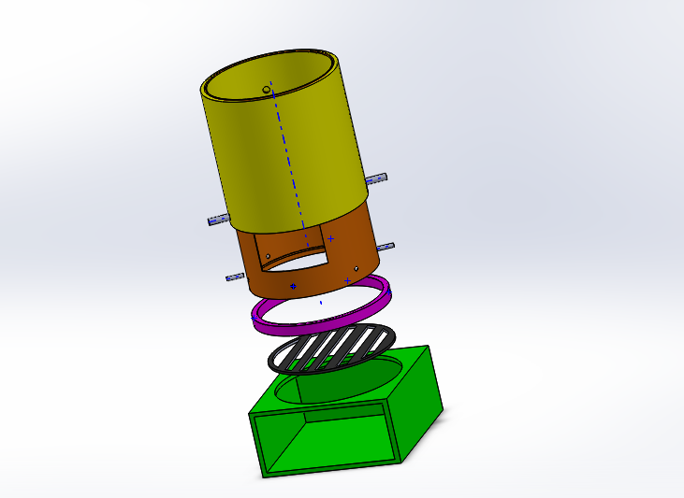
Design of Gasifier cook stove
Secondary duct
Main chamber
Primary duct
Grate
Base part

Slide 14
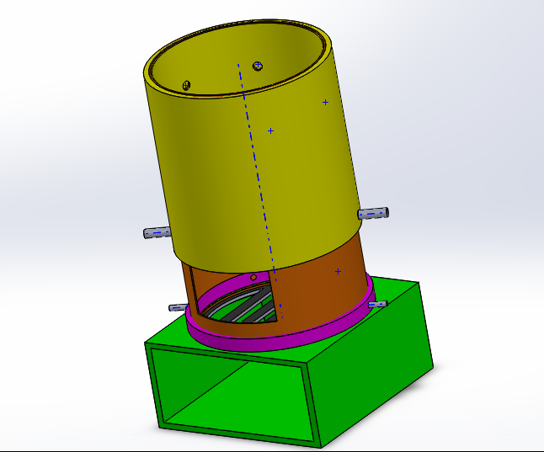
Design of Gasifier cook stove
Secondary air supply
Primary air supply

Slide 15
Modifications could be done
Electricity through heat:
Generate electricity while using the improved cookstove for cooking.
Energy generated on the rims and surface of the stove is used to generate electricity by using thermo-electric generators – Petlier Generator (made up of p-n junction diodes).
Heat Box
Double pot system can help to sustain heat which may helpful in drying purpose.

Slide 16
Thank
You

